Slide 1

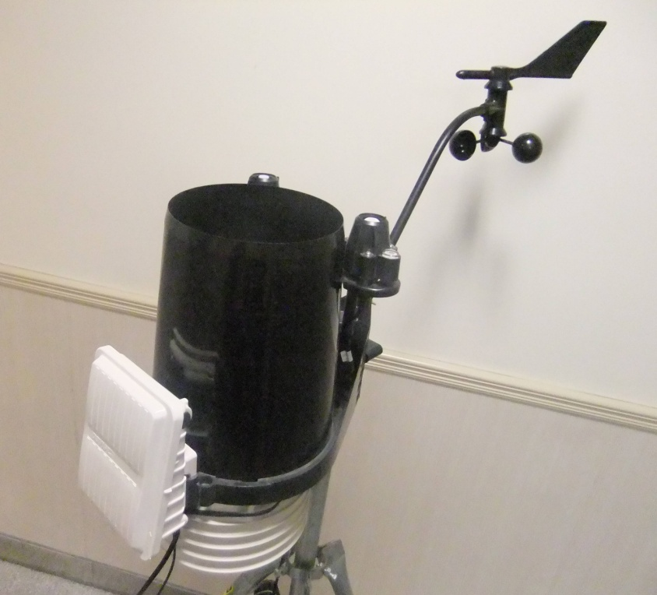
Automatic Weather Station (AWS)

Slide 2
Introduction
What is AWS?
What is Weather Information??
Integrated meteorological sensors
Automatic remote data acquisition
Collect weather information

Slide 3
Weather Information
Temperature
Solar Radiation
Ultra Violet Index (UVI)
Relative Humidity
Rainfall
Pressure
Wind Speed & Direction

Slide 4
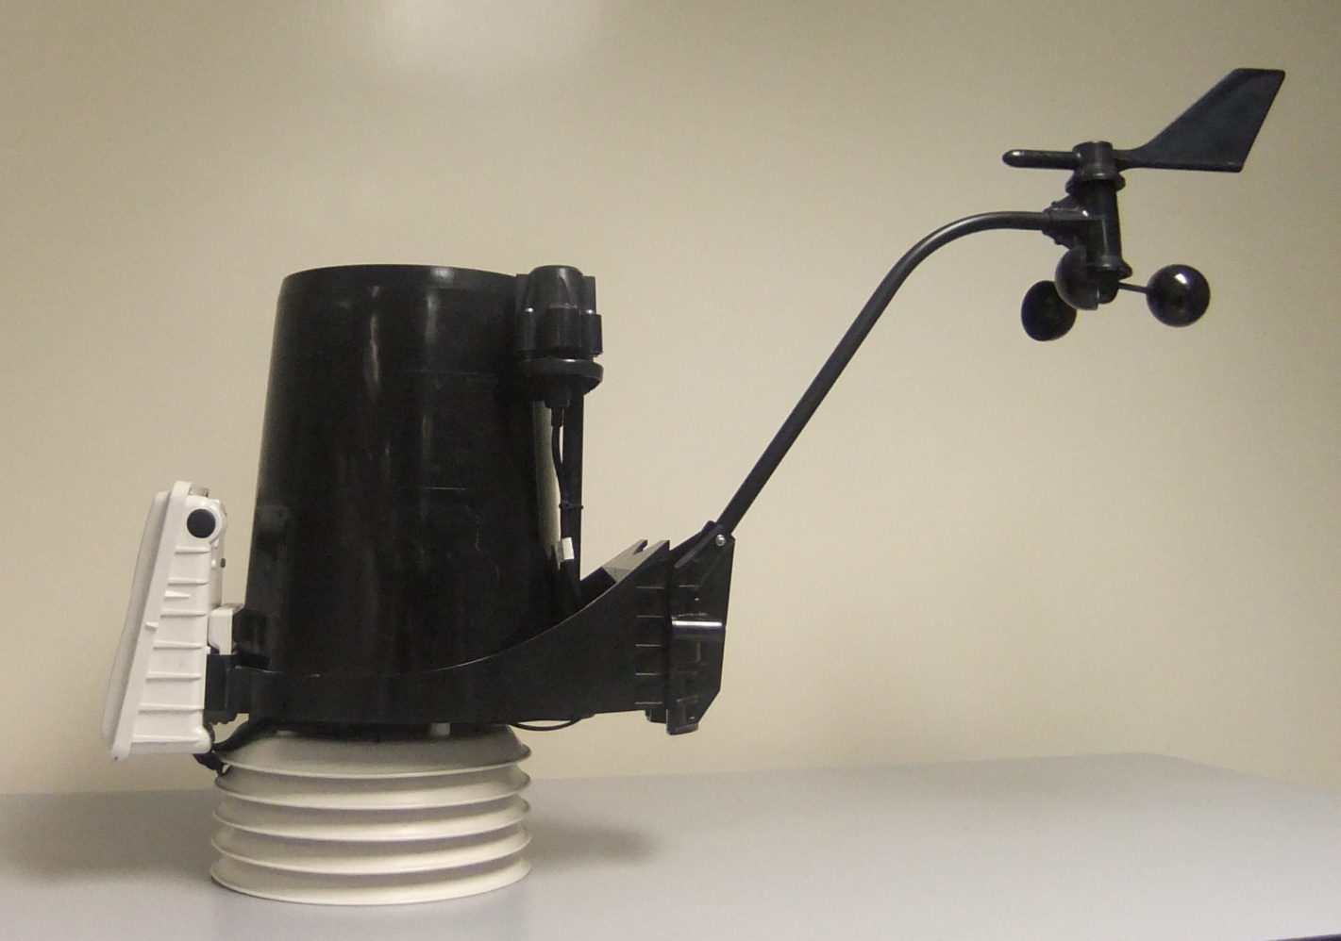
All Components of AWS
ISS
(Integrated
Sensors
Station)
Anemometer

Slide 5
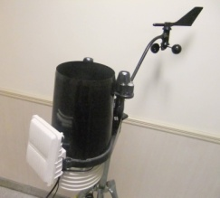
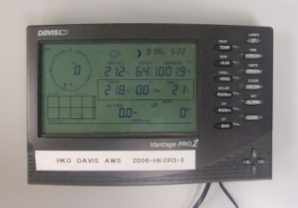
Temperature
Two Thermometers in AWS
Unit: Degree Celcius (ºC)
Outdoor (ISS)
Indoor (Console)

Slide 6
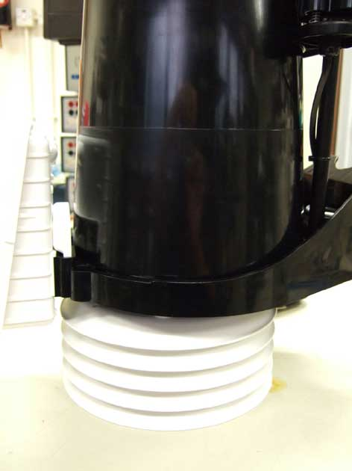
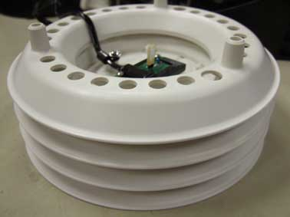
Outdoor Thermometer
Sensor board
Radiation shield

Slide 7
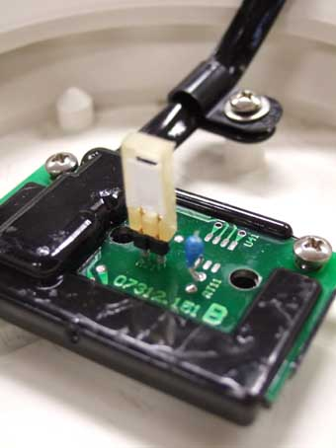
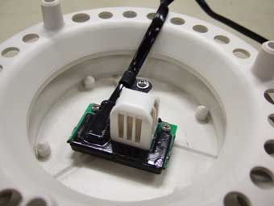
Outdoor Thermometer
Thermistor
Inside radiation shield
Thermistor:
Resistance varies with temperature

Slide 8
Outdoor Thermometer
Why should it be installed in the radiation shield?
Dry air Temperature
Prevent the direct solar radiation
Good Ventilation
Radiation Shield

Slide 9
Relative Humidity
Two Hygrometers in AWS
Represent in percentage (%)
Outdoor (ISS)
Indoor (Console)
RH = 100% ?
Water vapor in air is saturated, no more water can be carried by air.

Slide 10
Outdoor Hygrometer
Inside radiation shield (next to the thermometer)
Working Principle:
  Measure the change in resistance or capacitance to evaluate change in humidity.
Hygrometer

Slide 11
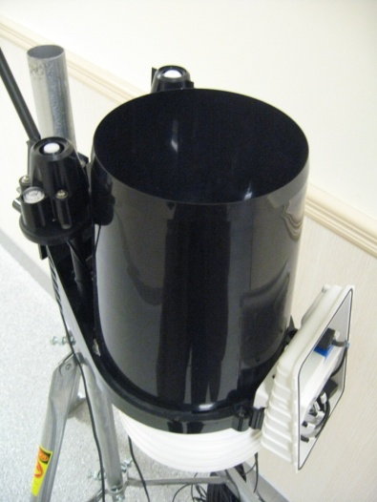
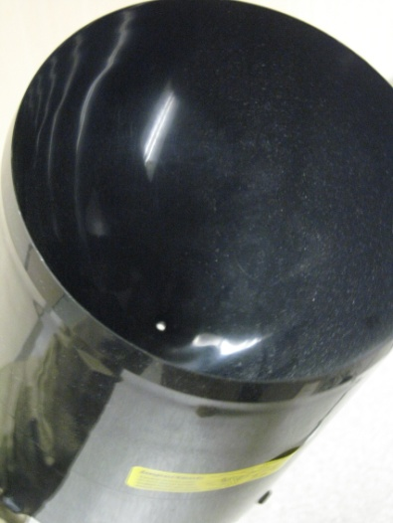
Rainfall
Used by HKO
Unit: mm / in
Funnel shape rain collector
Collect rain drops
Rain collector
Hole

Slide 12
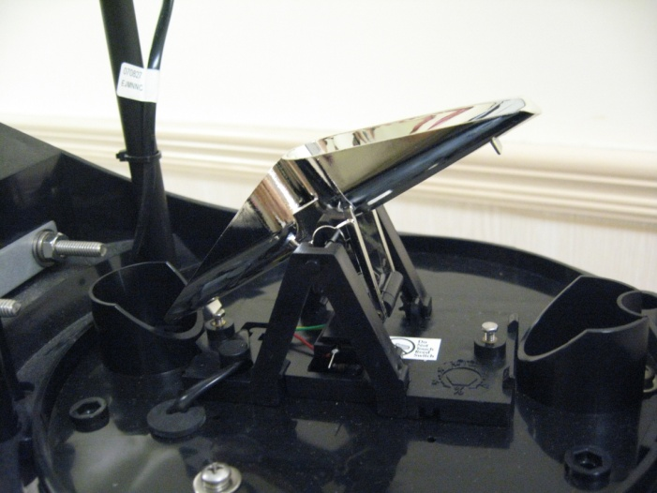
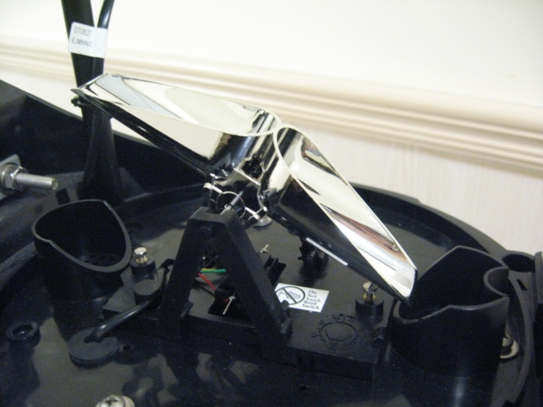
Rainfall
Bucket A collect raindrops
Bucket A heavy, fall and pour away rainwater
+
Bucket B rises and collect raindrops
Bucket B heavy, fall and pour away rainwater
+
Bucket A rises and collect raindrops
A
B
Cycle
Cycle
B
A
1 tip = 0.2 mm
Rainfall = tipping times x 0.2 mm

Slide 13
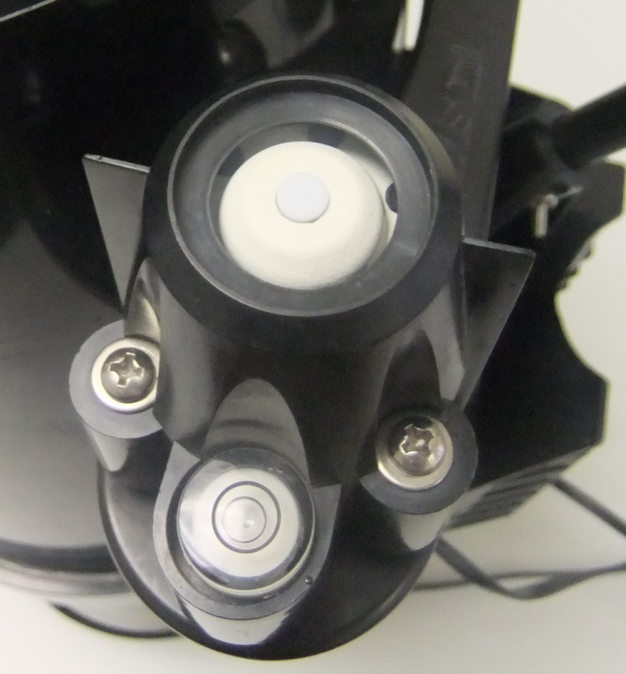
Ultra Violet (UV) Index
Sensor
Wavelength(λ) for UVI: 295 to 325 nm
Adjusted according to the sensitivity of human skin (McKinlay-Diffey Erythema action spectrum)
No unit
Typical value:
  15 (highest record in HK)
Bubble Level

Slide 14
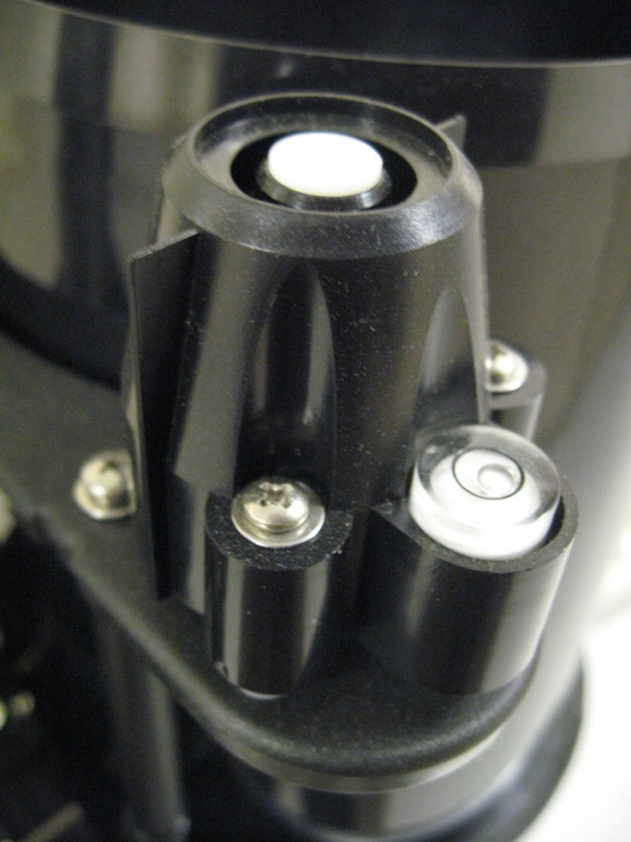
Solar Radiation
Power of sunlight on a surface - irradiance
Unit:
Watt per meter square (Wm⁻²) - Power per unit area
Sensor
Bubble Level

Slide 15
Solar and UV sensor
Bubble Level
To ensure the sensor is horizontal to the sea level
Why?
Detect the non-directional radiation
bubble level
Adjust the sensors until the bubble is at the centre of the black circle

Slide 16
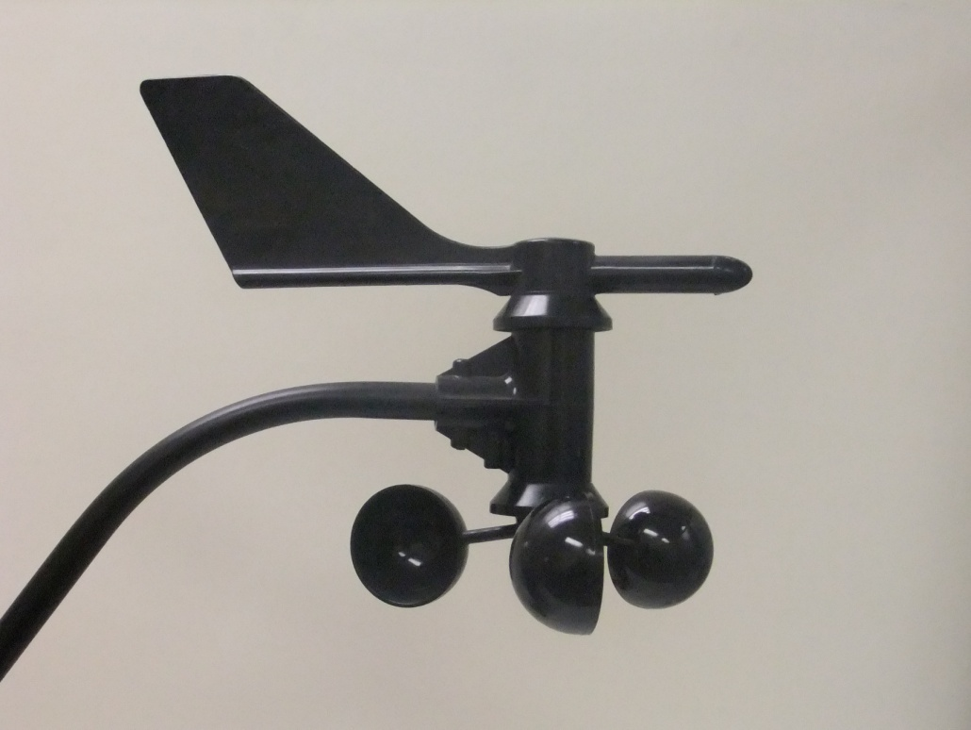
Wind Speed
3 Wind Cups at Anemometer
Unit:
Miles per hour (mph)
Kilometer per hour (km/h)
Meter per second (m/s)
Wind vane
Wind cup
Used by HKO
Anemometer

Slide 17
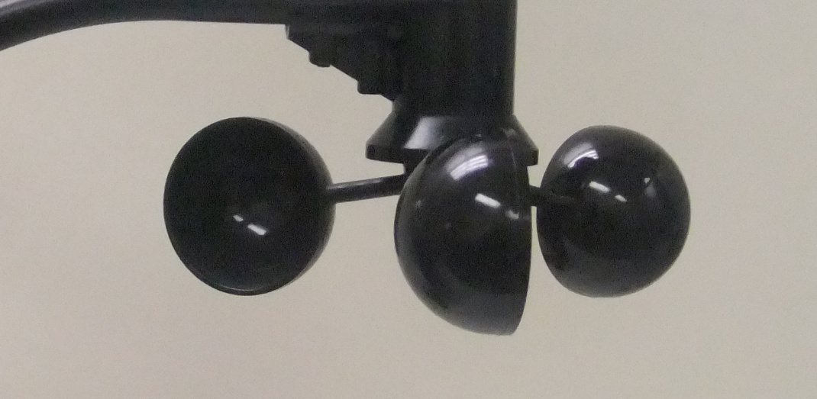
Wind Speed
How??
Higher frequency -> higher wind speed
Wind cups catch wind
Wind cups rotate if wind speed high enough
Wind

Slide 18

Wind Direction
Record the wind direction
Wind vane points to where the wind come from
Mounting bar must point to north when install
Expressions:
  degree (º)
  16 directions
  (i.e, E, S, W, N, NE, SE, NW, SW, NNE, ENE, ESE, SSE, NNW, WNW, SSW, WSW)
Wind vane
Point North
Mounting bar

Slide 19
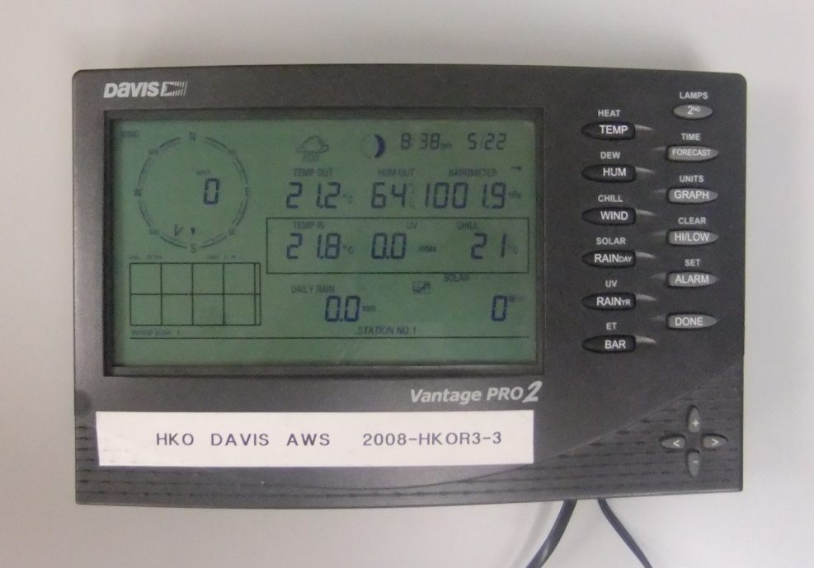
Pressure
Barometer in the console
Working principle:
  Measure the resistance of thin film (薄膜) in piezoresistive (壓阻式) sensor exerted by the atmosphere
Unit:
  Millimeter of mercury (mmHg)
  Millibar (mbar)
  Hectopascal (hPa)
Pressure trend:
important for weather forecasting
Used by HKO
Hecto = 100

Slide 20
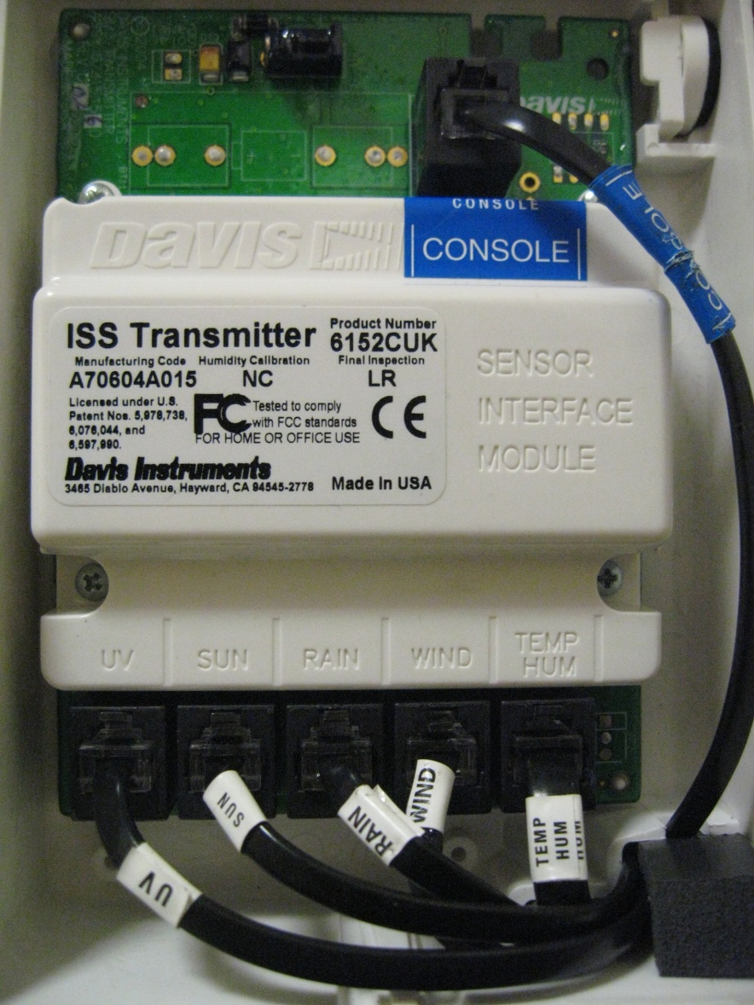
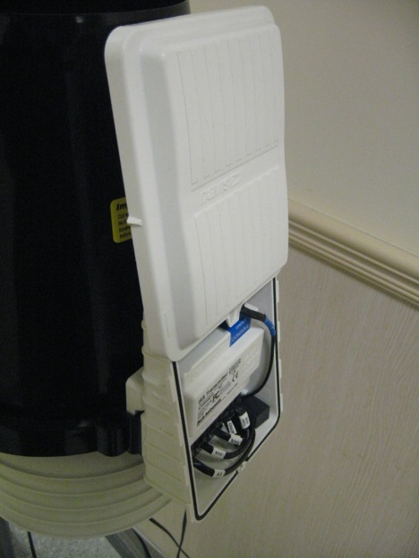
Sensor Interface Module
Collect raw data from all sensors
Transmit coded data to the console
Max range: 300m
Console
UV
SUN
RAIN
WIND
TEMP
& HUM

Slide 21

Console
Receive and decode data from sensor interface module
Display latest weather information
Transfer data to computer for:
  display and storage
  webpage generation
  sending back to Co-WIN database server

Slide 22

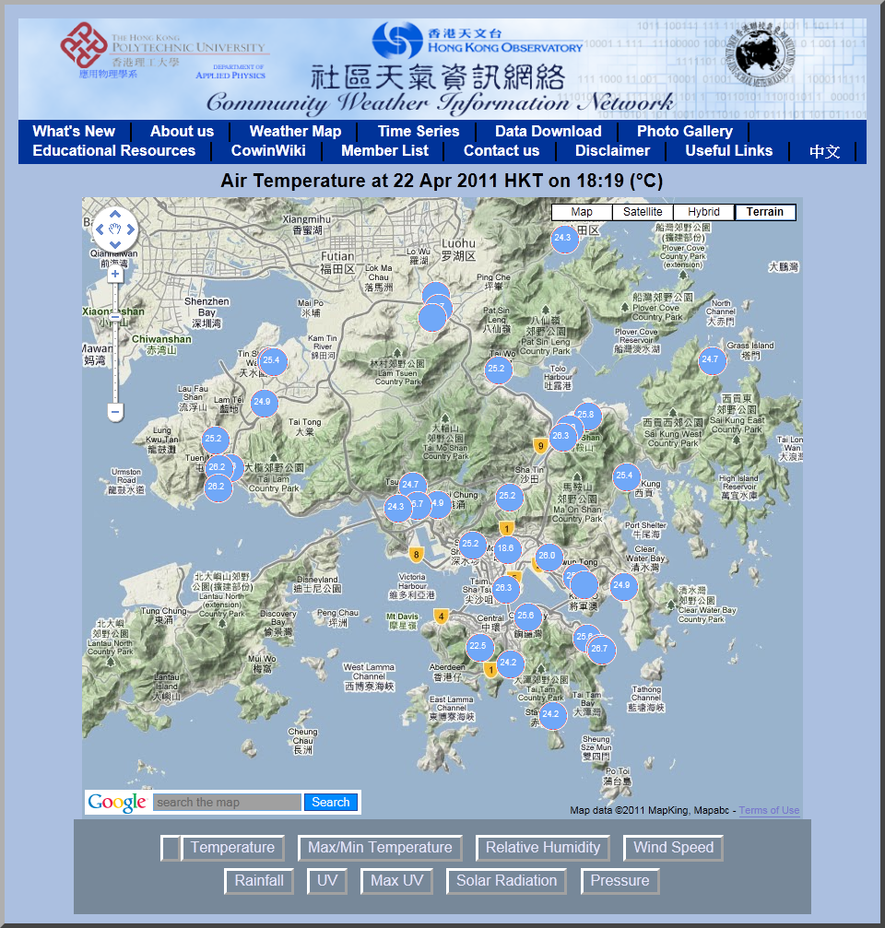
Co-WIN website
Website: http://weather.ap.polyu.edu.hk/
Co-developed by HKO and PolyU AP

Slide 23
Co-WIN website
AWSs located at different school and organization members
Keep sending data back every minute to Co-WIN database server in the Department of Applied Physics, HKPolyU via internet
Provide latest weather information to the public
As a local weather reference complementary to weather stations of HKO

Slide 24

Co-WIN website
Parameters in weather map:
  Temperature
  Max/Min Temperature
  Relative Humidity
  Wind Speed
  Rainfall
  UV Index
  Solar Radiation
  Pressure

Slide 25
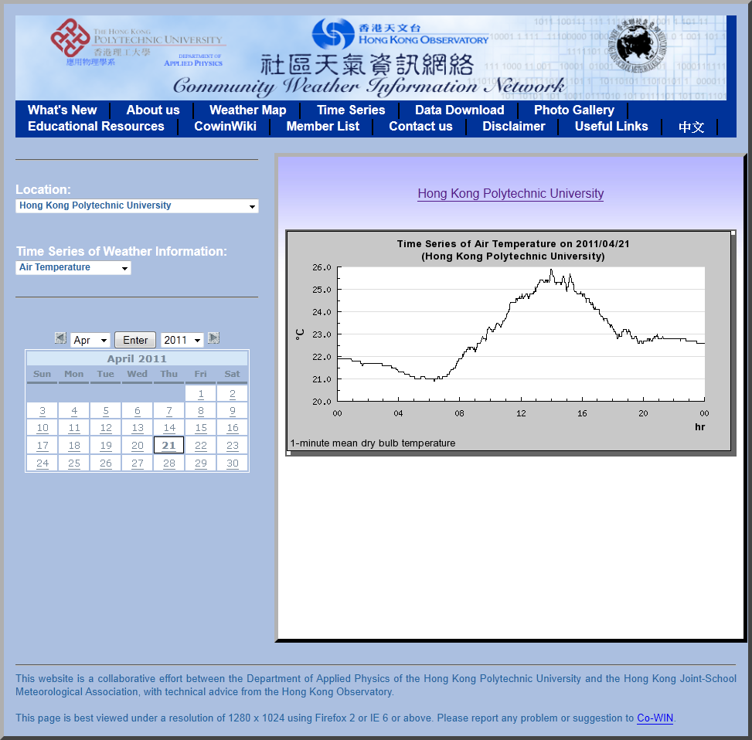
Co-WIN website
View weather data history from different location
Time series display

Slide 26

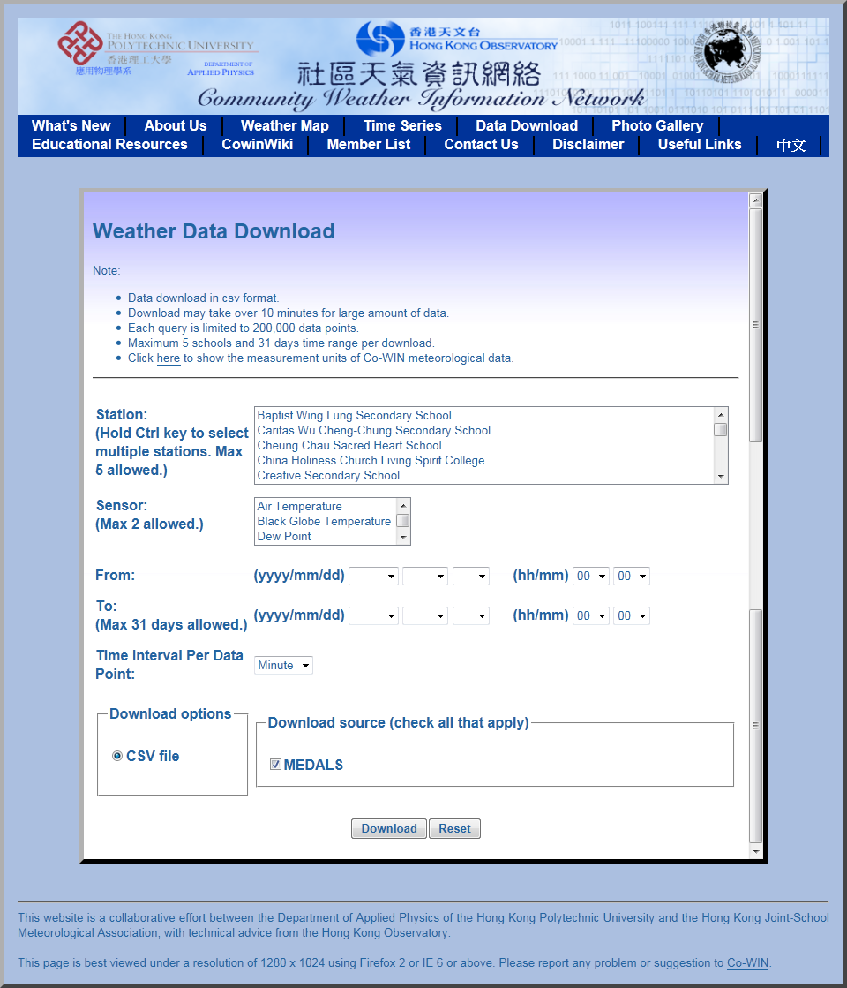
Co-WIN website
Download weather data history
Data exported in .csv format
MS Excel compatible

Slide 27
Co-WIN website
Development
  More weather information will be available soon
  Release of new design with Google map
  Integrate more functions for mobile learning

Slide 28
END

