Slide 1
Evaluation of meteorological sensors for use in portable automatic weather station development 29/6 – 21/8
R3(b) LAW, Suet Sum

Slide 2
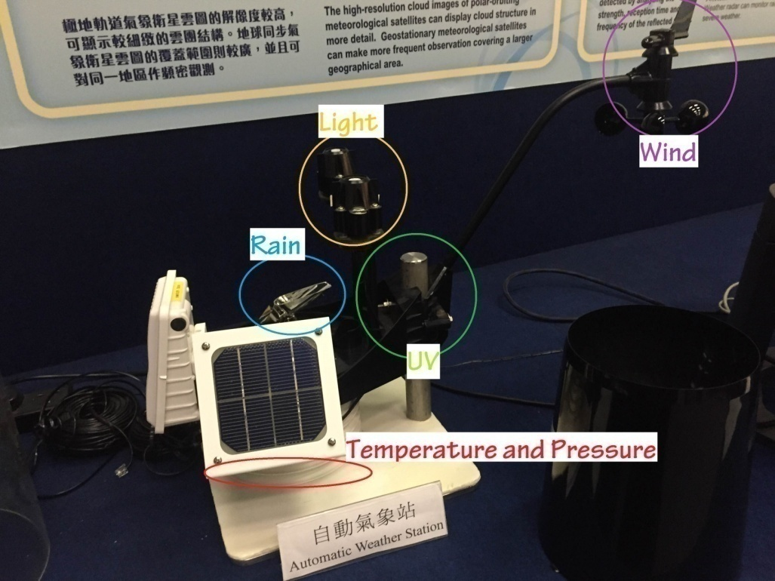
Community Weather Information Network
Objectives:
Gather weather information
Uploaded to the internet for the public
Promote meteorology and environmental education
Automatic Weather Station

Slide 3
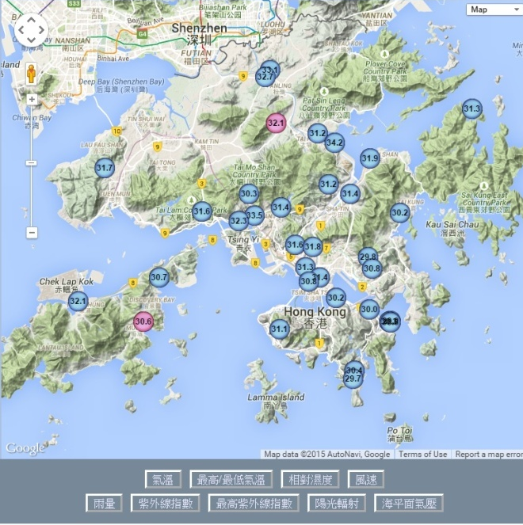
Community Weather Information Network
New AWS
Smaller, Cheaper
Can be improved
Editing the program
Adding the electronic components
Creates opportunities for the students to build an automatic weather station (AWS)

Slide 4
Structure
Accuracy
Consistency Linearity
Phase I Comparison of sensors
Phase II Design and Develop AWS
NOW

Slide 5
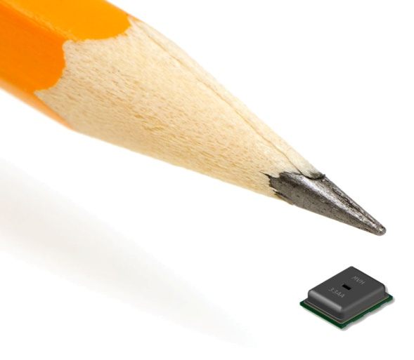
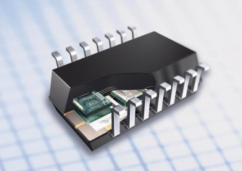
Mobile Sensors Analysis
Type of sensors
Thermistor (Temperature sensor)
Resistance depends on temperature ∆R = k ∆T
Photodiode (Photon sensor)
Photon generates current and current was amplified
Phototransistor (Light sensor)
Schottky-type Photodiode (UV sensor)
MEMS sensor
Micro-electro-mechanical system sensor
Technology of very small devices

Slide 6
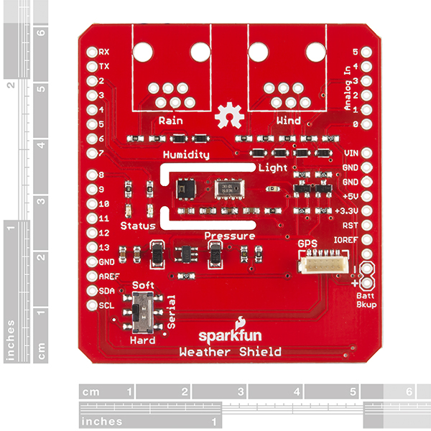
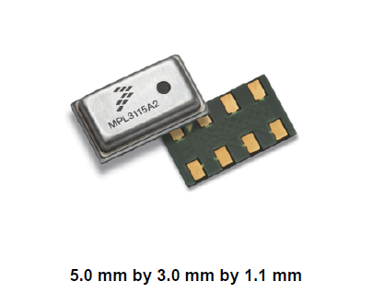
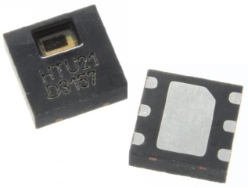
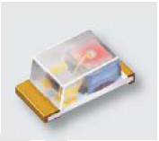
Mobile Sensors Analysis
Weather Shield
HTU21D (Temperature, Humidity) [MEMS]
MPL3115A2LGA8 (Pressure) [MEMS]
ALS-PT19 (Light level) [Photodiode]

Slide 7
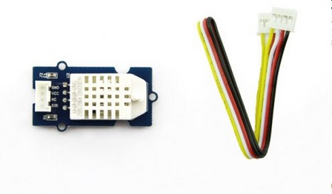
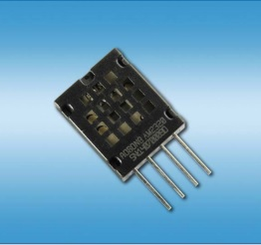
Mobile Sensors Analysis
Grove – Temperature and Humidity Sensor Pro
AM2320 (Temperature, Humidity) [Thermister]

Slide 8
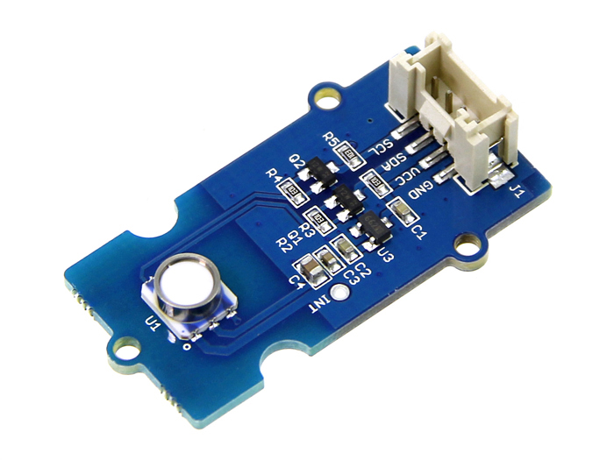
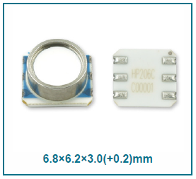
Mobile Sensors Analysis
Grove – Barometer (High-accuracy)
HP206C (Pressure, Temperature) [MEMS]

Slide 9
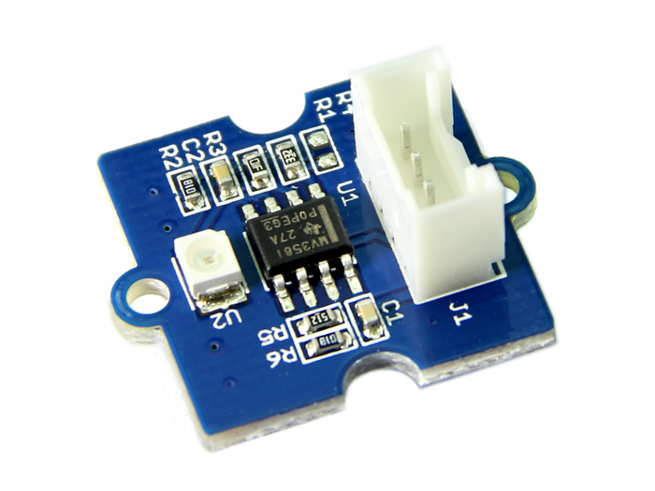
Mobile Sensors Analysis
Grove – UV sensor
GUVA – S21D (Ultraviolet) [Photodiode]

Slide 10
Mobile Sensors Analysis
 | HTU21D | MPL3115A2LGA8 | HP206C | AM2320
Temperature (ºC) | ±0.3 | ±1 | ±1 | ±0.5
Long Term Drift (year) | ±0.04 | ±0.1 | / | ±0.1
Humidity (%) | ±1 | / | / | ±3
Long Term Drift (year) | ±0.5 | / | / | ±<0.5
Pressure (kPa) | / | ±0.4 | ±0.3
Long Term Drift (year) | / | ±0.1 | ±0.15
 | GUVA – S21D | ALS-PT19
Sensitivity wavelength | 240-380 (nm) [UV] | 390-700 (nm) [visible light]
Sensitivity area | 0.076 | >0.076

Slide 11
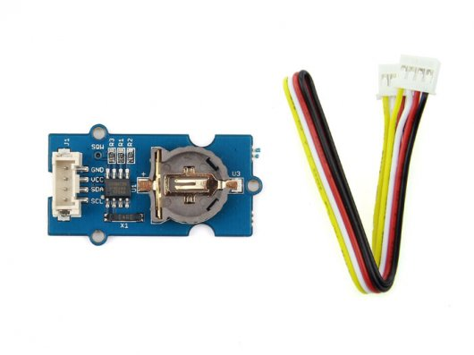
Electronic Components Analysis
Grove - RTC
real time clock that can record the date and time.

Slide 12
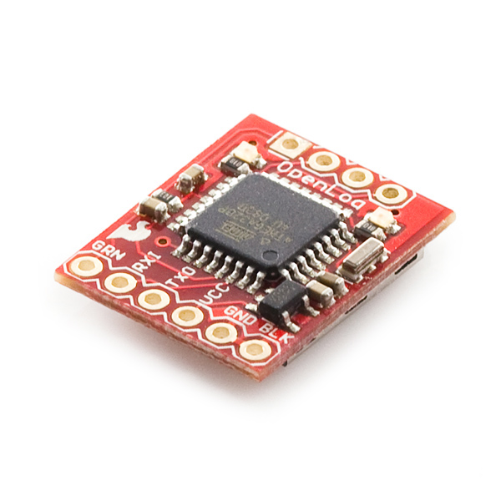
Electronic Components Analysis
Openlog
data logger
Micro SD card
Serial port to CSV text file

Slide 13
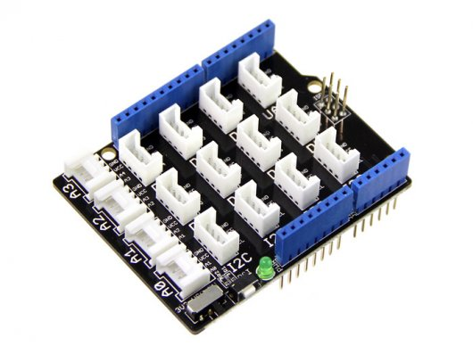
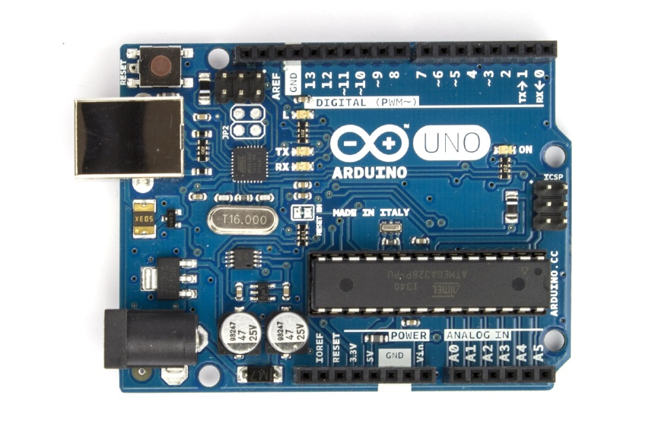
Electronic Components Analysis
Grove - Base Shield
I2C Port
Arduino Uno
Control other electronic components
Arduino LCD Monitor
Display sensor value

Slide 14
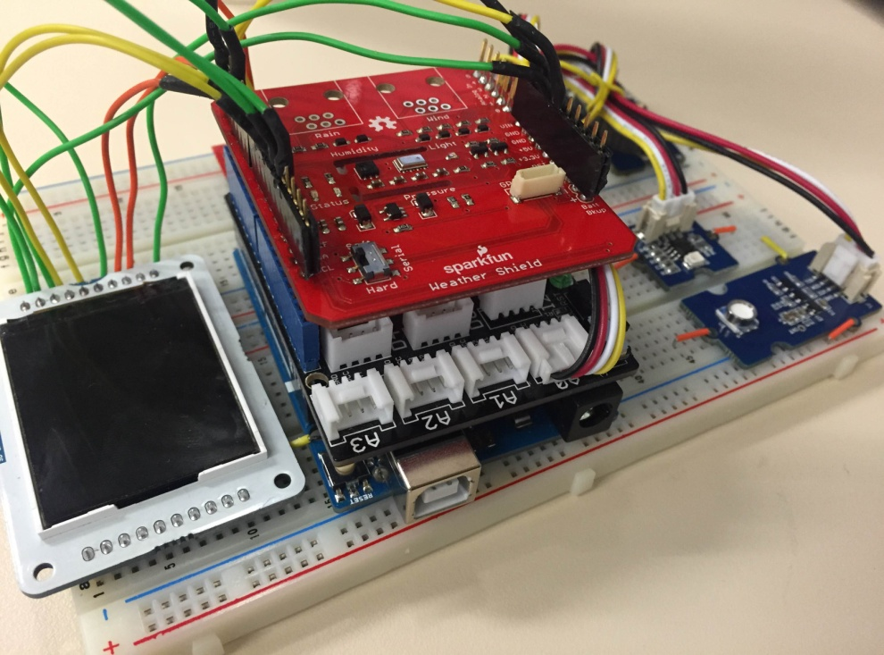
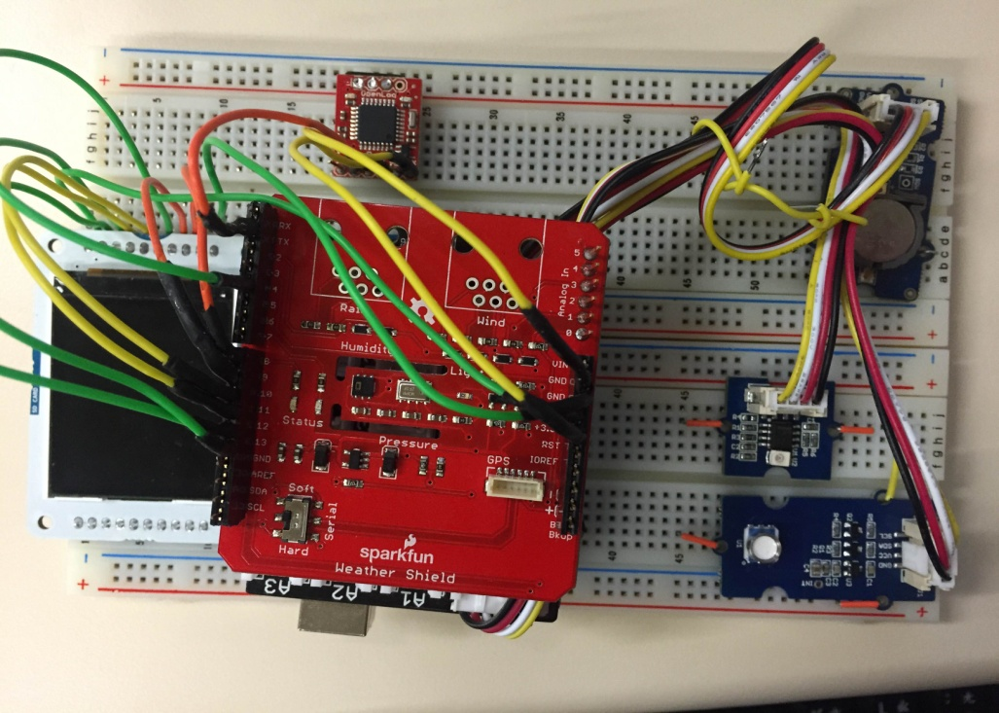
Phase I
Test bed 1

Slide 15
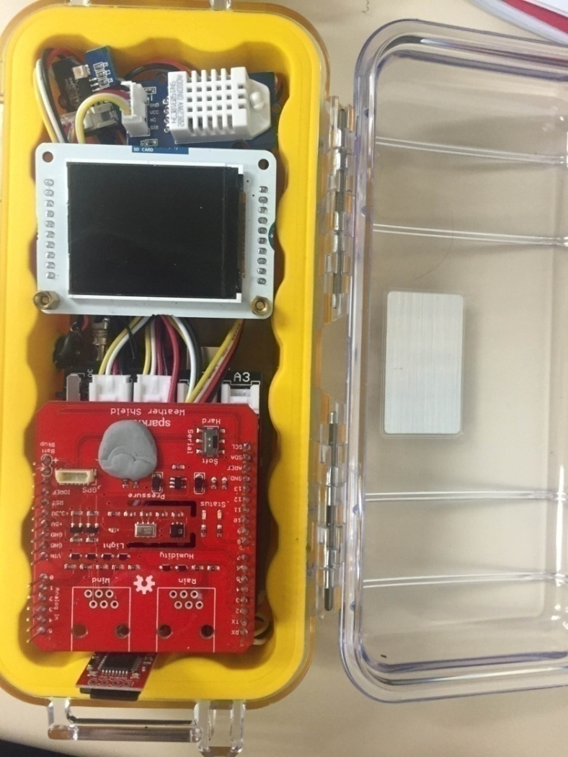
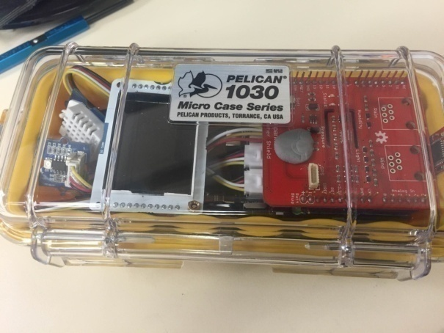
Phase I
Test bed 2

Slide 16
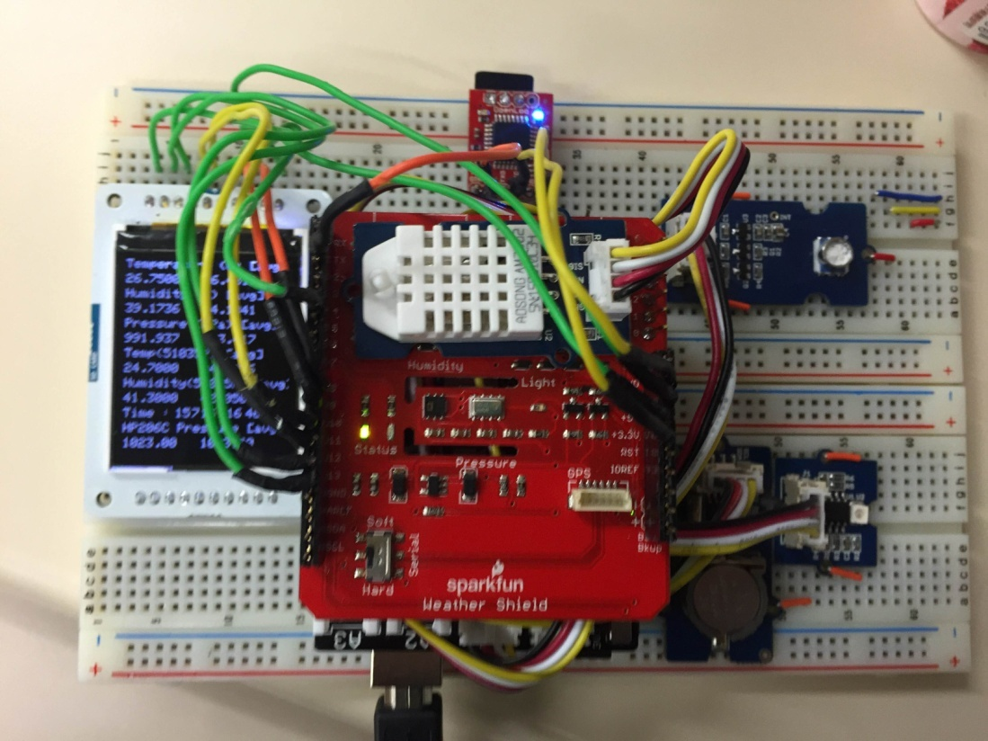
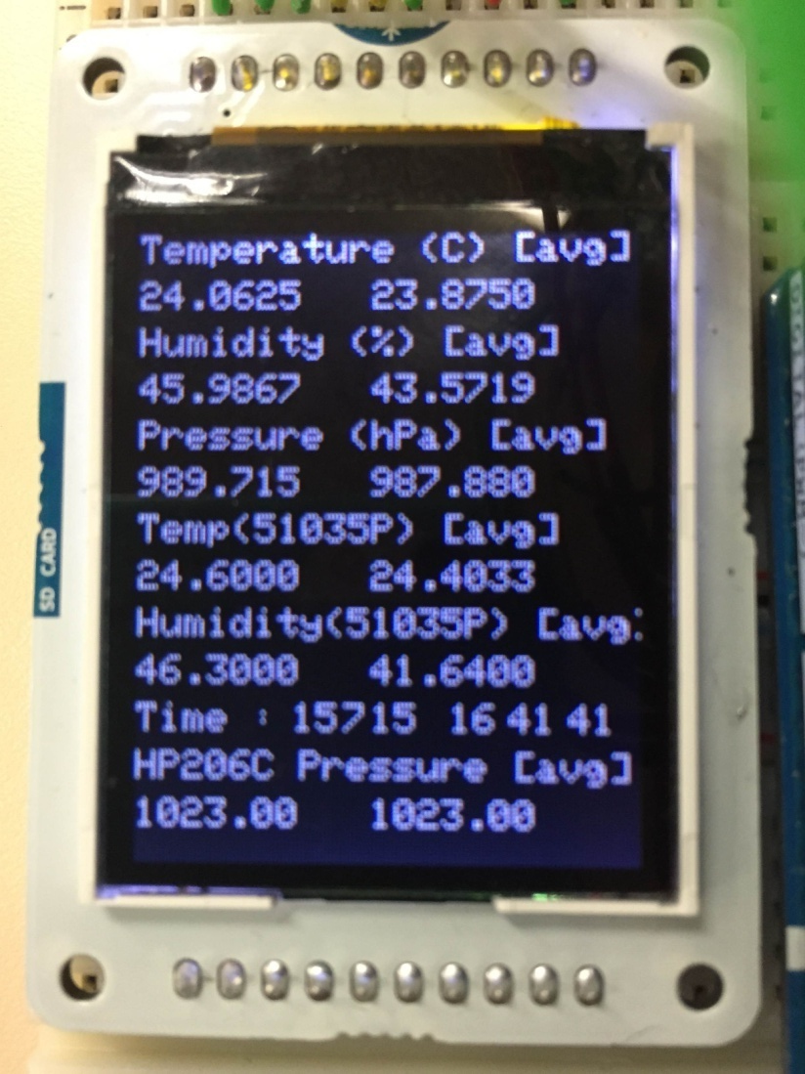
Phase I
Notes:
Renew picture

Slide 17
Phase I
Serial Port to CSV text file
Comma Separated Variable
Serial Port opened by Arduino
Text file opened by Note Pad
CSV text file opened by Excel
Statistical analysis or comparison can be done!

Slide 18
Comparison of sensors
Consistency of Sensors
Sensor value should be no difference under same condition
Plot Sensor value versus Standard value
Linear correlation coefficient R
Try to find if they have linear relationship
Perfect case : R² = 1
Observe the equation
Equation of graph : y = mx + c
Perfect case : y (Sensor) = x (Standard)
m = 1 ; c = 0

Slide 19
Comparison between sensors and PRT [Temperature]
Sensors HTU21D AM2320 HP206C
Consistency

Slide 20
Comparison between sensors and PRT [Temperature]
Consistency
HTU21D [2]
1.5ºC Difference
HTU21D [1]
PT100 standard

Slide 21
Comparison between sensors and PRT [Temperature]
Consistency
AM2320 [1]
AM2320 [2]
<0.5ºC Difference
PT100 standard

Slide 22
Comparison between sensors and PRT [Temperature]
Consistency
HP206C [1]
~1ºC Difference
HP206C [2]
PT`100 standard

Slide 23
Comparison between sensors and PRT [Temperature]
Consistency
HTU21D
HP206C
AM2320

Slide 24
Comparison between sensors and PRT [Temperature]
HTU21D {Room Temperature}
Fluctuations

Slide 25
Comparison between sensors and PRT [Temperature]
HTU21D {Room Temperature}
Below 25ºC is not well fit

Slide 26
Comparison between sensors and PRT [Temperature]
HTU21D/AM2320 {Below 25ºC}
Almost 2 ºC
AM2320

Slide 27
Comparison between sensors and PRT [Temperature]
HTU21D/AM2320 {Below 25ºC}
y=x
AM2320

Slide 28
Comparison between sensors and PRT [Pressure]
Sensors MPL3115A2LGA8 HP206C
Consistency

Slide 29
Comparison between sensors and King’s Park instrument [Pressure]
Consistency

Slide 30
Comparison between sensors and King’s Park instrument [Pressure]
Consistency
HP206C [1]
HP206C [2]

Slide 31
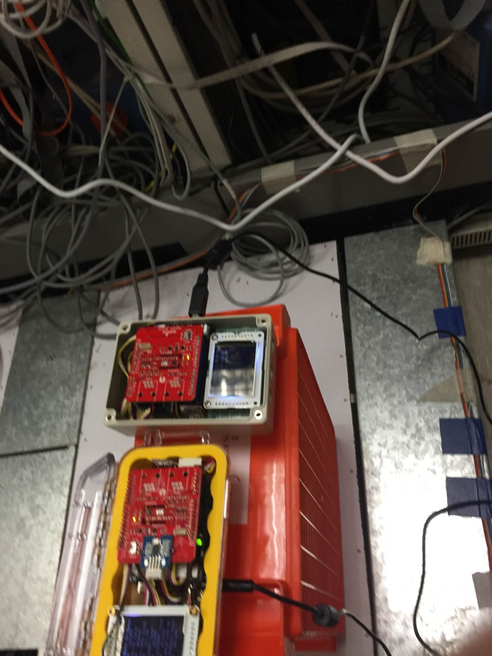
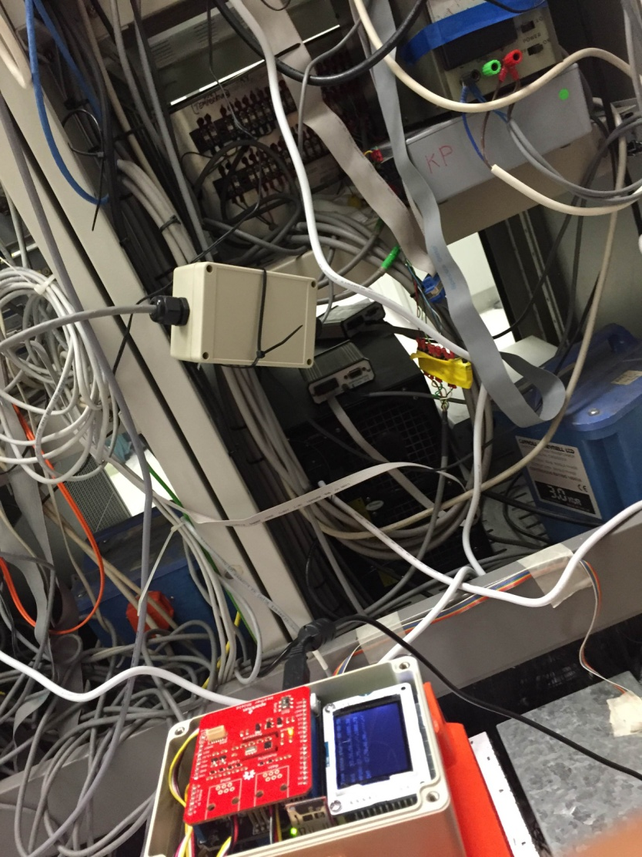
Comparison between sensors and King’s Park instrument [Pressure]

Slide 32
Comparison of sensors in King’s Park
MPL3115A2LGA8/HP206C

Slide 33
Comparison between sensors and King’s Park instrument [Pressure]
MPL3115A2LGA8/HP206C
MPL3115A2LGA8
HP206C
King’s Park
HP206C

Slide 34
Comparison between sensors and King’s Park instrument [Pressure]
MPL3115A2LGA8/HP206C
y=x

Slide 35
Comparison between sensors and King’s Park instrument [Humidity]
Sensors HTU21D AM2320
Consistency

Slide 36
Comparison between sensors and King’s Park instrument [Humidity]
Consistency
AM2320 [1]

Slide 37
Comparison between sensors and King’s Park instrument [Humidity]
Consistency
HTU21D [1]
HTU21D [2]

Slide 38
Comparison between sensors and King’s Park instrument [Humidity]
HTU21D/AM2320

Slide 39
Comparison between sensors and King’s Park instrument [Humidity]
HTU21D/AM2320

Slide 40
Comparison between sensors and King’s Park instrument [Light]
ALS-PT19

Slide 41
Comparison between sensors and King’s Park instrument [Light]
ALS-PT19

Slide 42
Comparison between sensors and King’s Park instrument [UV]
GUVA – S21D

Slide 43
Comparison between sensors and King’s Park instrument [UV]
GUVA – S21D

Slide 44
Preparation of Phase II
Schematics + circuit board design
Display
Battery Ports
Clock Battery Teensy

Slide 45
Selected Sensors
 | Sensors Name
Temperature | AM2320
Pressure | HP206C
Humidity | ?
Light | ?
UV | ?
Offset can be added to the program

Slide 46
Next time…
Sensors tested in King’s Park
Humidity
Light
UV
Circuit Board
Design
Comparison Test
~~Thank you~~

Slide 47
Problems should be encountered in Phase II
Temperature
Mobile phone can reach 60 ºC in summer on the roof top
Will such a temperature affect the sensitivity and accuracy of the sensors?

