Slide 1
Simplified Computation on Nuclear Decay
核衰變的簡單計算
香港理工大學
應用科學及紡織學院
應用物理學系
季宇飛

Slide 2
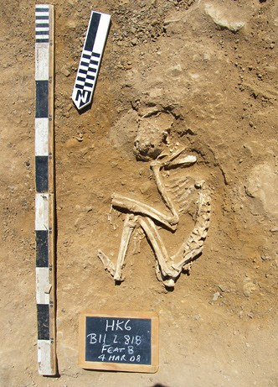
Body Remains Found In Egypt
How old is he?

Slide 3
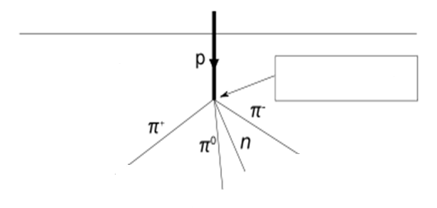

Source of C-14
碳十四的來源
Cosmic Rays
宇宙射線
Air
neutron

Slide 4


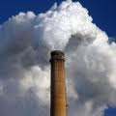
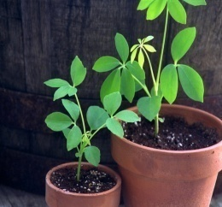
Carbon Cycle
碳循環
Atmosphere
Carbon
Animals
Fossil Fuels
Plants

Slide 5
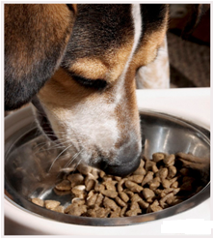
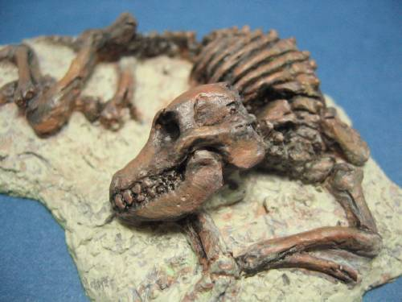
C-14 Atoms in a Dog’s Body
Input
C-14 from the outside
Output
C-14 decay

Slide 6

Decay of Carbon-14 atoms
碳十四的衰變
Decay of C-14
Unstable
Stable
N(t), No. of C-14 atoms
λ is constant

Slide 7
Decay of Carbon-14 atoms
碳十四的衰變
N0

Slide 8
Decay of C-14
碳十四衰變
N0
0.5N0
0.25N0
半衰期: 5730 years
No. of C-14 Atoms
Time

Slide 9
Age of the Dead Body
No. of C-14/kg (Alive and Past), N₀
ln
No. of C-14/kg (Dead and Now), N_{t}
Age=
λ(constant)

Slide 10
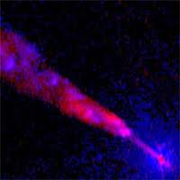
Reasons for C-14 Level change
C-14
in the living body
N0
C-14
in the air
Magnetic field of the Earth,
Solar activity…..
Cosmic Rays

Slide 11
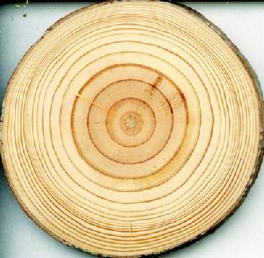
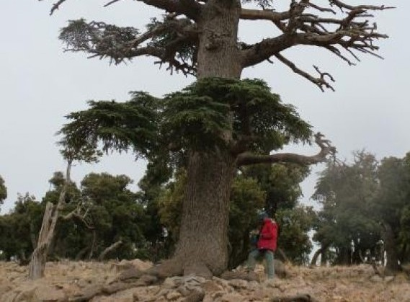
History of Carbon-14 Level in the Air
歷史上空氣中碳十四之含量
C-14 level
for different years
1930
1920
1940

Slide 12
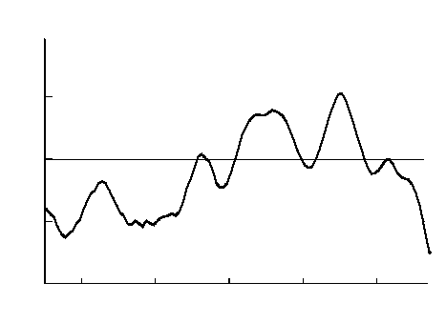
History of Carbon-14 Level in the Air
歷史上空氣中碳十四之含量
4
2
Change of C-14 (%)
N0 of 1950
0
-2
-4
1000 1200 1400 1600 1800
Year

Slide 13




Age of the Dead Body
N₀ ,Alive
ln
Age=
N_{t} = /kg
N_{t} ,Now
λ(constant)
1950 N₀ = /kg, Age=11500 years
1700 N₀ = /kg, Age=12000 years
1000 N₀ = /kg, Age=11000 years
Error
10% Change for N₀
About 1000 years difference

Slide 14
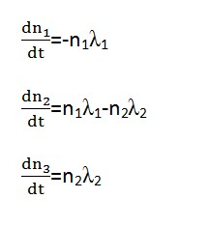
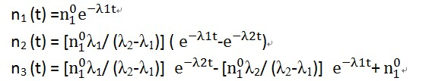

Two-decay Process
Isotope 1 → Isotope 2 → Isotope 3

Slide 15
A Typical Two-decay Process
典型的兩次衰變過程

Slide 16
Thank you for listening!

