Slide 1
Arduino AWS
Prototype Arduino based AWS
John KW Chan
Scientific Officer
Hong Kong Observatory
November 2014

Slide 2

Arduino AWS Project
Project Objectives
  Open-source electronics platform
  Modular, easy-to-use hardware and software
  Freely available accurate sensors
  Customisable and expandable by user
  NO operating system

Slide 3
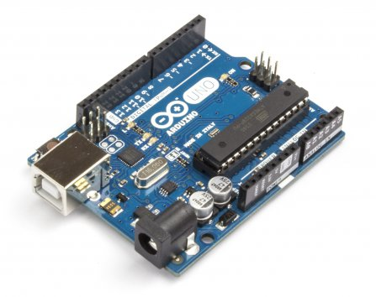
Arduino AWS Project
Arduino UNO Microprocessor Board (“The One”)
  UNO R3 (SMD)
    14 digital input/output pins
    6 analog inputs
    16 MHz clock
    Small form factor

Slide 4
Arduino aws project
Sensors
  Temperature
  Humidity
  Pressure
  Rainfall

Slide 5
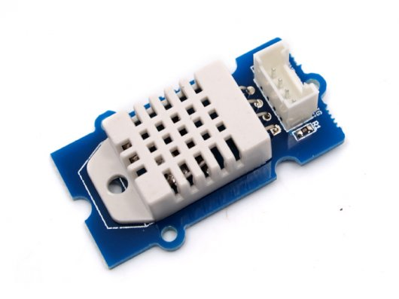
Arduino aws project
Temperature and Humidity Sensors
  Model SEN51035P
  Grove – Temperature and Humidity Sensor Pro

Slide 6
Arduino aws project
Items | Conditions | Min | Norm | Max | Unit
VCC | - | 3.3 | - | 6 | Volts
Measuring Current Supply | - | 1 | - | 1.5 | mA
Standby Current Supply | - | 40 | - | 50 | uA
Measuring Range | Humidity | 5% | - | 99% | RH
 | Temperature | -40 | - | 80 | °C
Accuracy | Humidity | - | - | ±2% | RH
 | Temperature | - | - | ±0.5 | °C
Resolution | Humidity | - | - | 0.1% | RH
 | Temperature | - | - | 0.1 | °C
Repeatability | Humidity | - | - | ±0.3% | RH
 | Temperature | - | - | ±0.2 | °C
Long-term Stability | - | - | - | ±0.5% | RH/year
Signal Collecting Period | - | - | 2 | - | S
Respond Time | 1/e(63%) | 6 | - | 20 | S

Slide 7
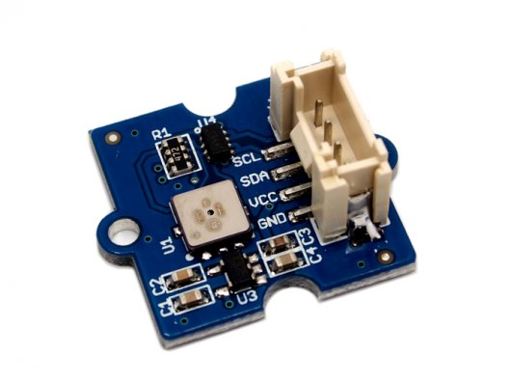
Arduino aws project
Pressure Sensor
  Model SEN05291P
  Grove - Barometer Sensor

Slide 8
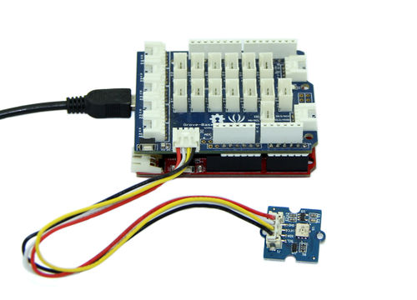
Arduino aws project
Item | Min | Typical | Max | Unit
Voltage | 3 | 5 | 5.5 | VDC
Current | 89 | / | 130 | uA
Pressure Range | 300 | / | 1100 | hPa
Faster I2C data transfer | / | / | 3.4 | MHZ
Dimension | 20.4*24.3*9.7 |  |  | mm
Weight | 2 |  |  | g
Pressure Sensor
  Features
  Wide pressure range
  Fully calibrated
  Low power consumption: 5μA
  Low noise:

Slide 9
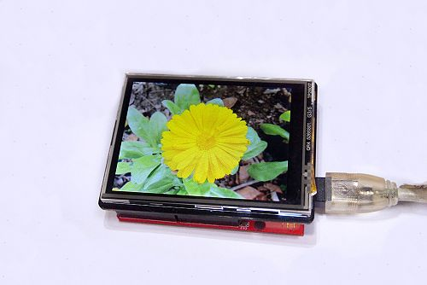
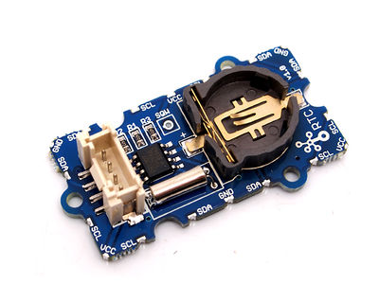
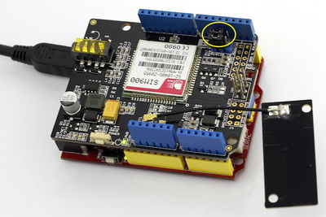
Arduino aws project
Display and Communication
  2.8” TFT Screen
  GPRS
Real Time Clock

Slide 10
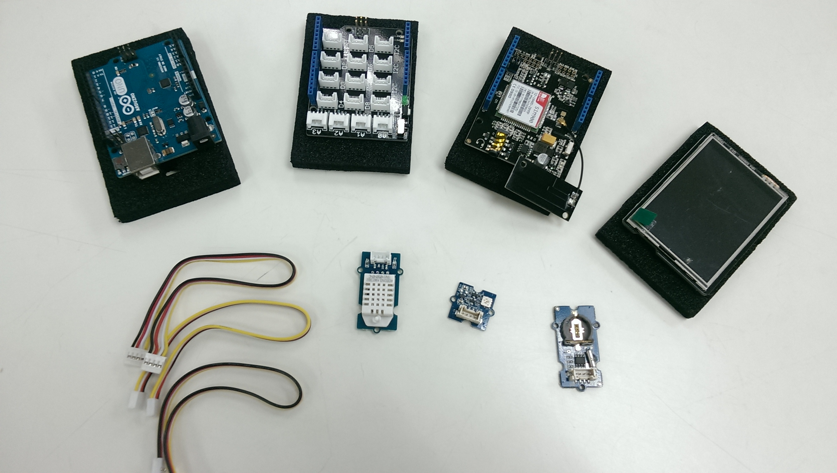
Arduino aws project

Slide 11
Arduino aws project
Software
  Arduino 1.5.8 IDE Beta
    Windows/Max OS X/LINUX (32 and 64 bit)
    Download from: http://arduino.cc/en/main/software
  Libraries and header files
    Each Sensors
    TFT Display
    IO/Communications

