Slide 1
Understanding common nuclear radiation units used in mass media (如何解讀新聞報導中 常見的核幅射單位)
Leung Tsun Kin,
Student of Department of
Applied Physics,
The Hong Kong Polytechnic University

Slide 2
Articles from the Web
Article 1
日本首次在食米驗出銫超標
農林水產省在福島縣二本松市生產的食米樣本, 初步驗出放射性銫含量,
超出政府規定, 達每公斤五百貝克
商業電台 12/9/2011
Article 2
放射銫污染擴散至日首都圈
千葉縣柏市和松戶等地土壤中
放射線量達每小時0.2至0.5微希
<<明報>>30/9/2011

Slide 3
Units of radiation
 | Unit | Definition
Activity (放射強度) | becquerel(Bq)(貝克) | Decay occur per second
Absorbed dose (吸收劑量) | gray(Gy)(戈瑞) | Ionized energy absorbed by 1kg of matter.
Effective dose (有效劑量) | sievert(Sv)(希沃特) Millisievert(mSv)(毫希) microsievert(µSv)(微希) | Radiation between different parts of body calculated by two weighting factors and absorbed dose. E = ∑(W_{T} x W_{R} x D) W_{T} = weighting factor of body tissues W_{R} = weighting factor of radiation D = absorbed dose Safety limit: 1mSv/yr (excluding background radiation)

Slide 4
Calculation example
Q : What is the effective dose of 1 Gy of alpha particle to bone marrow?
Given W_{R} of alpha particle = 20
W_{T} of bone marrow = 0.12
A : W_{T} x W_{R} x D = 0.12 x 20 x 1 = 2.4Sv
Q : What is the effective dose of 1 Gy of beta particle to liver?
Given W_{R} of beta particle = 1
W_{T} of liver = 0.04
A : W_{T} x W_{R} x D = 0.04 x 1 x 1 = 0.04Sv

Slide 5
Article analysis 1
日本首次在食米驗出銫超標
農林水產省在福島縣二本松市生產的食米樣本, 初步驗出放射性銫含量,
超出政府規定, 達每公斤五百貝可
商業電台 12/9/2011
Cesium-137 (銫-137) does not appear naturally.
Main source : nuclear power plant.
Safety limit of Cesium-137 for vegetables in Japan 370 Bq/kg →500 Bq/kg after Fukushima Incident.
IAEA(國際原子能機構) safety limit for Cesium-137 in vegetables: 1000Bq/kg.

Slide 6
Article analysis 2
放射銫污染擴散至日首都圈
千葉縣柏市和松戶等地土壤中
放射線量達每小時0.2至0.5微希
<<明報>>30/9/2011
Calculation: 1mSv/(0.2µSv x 24) ≈ 208 days
In this news, if the value measured does not decrease, living in that area for 208 days may over safety limit.

Slide 7
Article analysis 3
…radioactivity in the sea near Fukushima is 7.5 million times the normal values…
(news adopted from Corriere Online, 5/4/2011)
Given normal background radiation = 2.4mSv/yr

Slide 8
What happens if the article’s figure is true?
In this case, the effective dose ≈ 18000Sv/yr ≈ 6 Sv in 3 hours.
As 6 Sv dose is fatal to human, if so, people at there will die within days.
However, this did not happen.

Slide 9
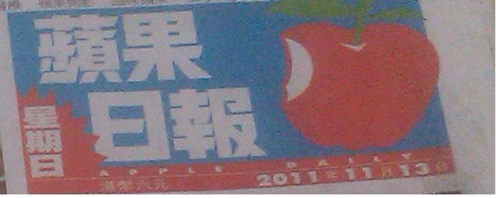
Recent news

